Slide 1
主管超連鎖™店主計劃之實踐
Implementation of Master UFO Program
Kawae Cheung
總顧問經理級 National Supervising Coordinator
四個佣金週期共賺取HK$76,600*
HK$76,600 in 4 Commission weeks
*本簡報中提到的收入等級純屬舉例說明，無意代表美安香港超連鎖™店主的一般收入，也無意表示任何超連鎖™店主皆可賺取同等收入。美安香港超連鎖™店主的成功與否，取決於其在發展事業時的努力、才能與投入程度。The income levels mentioned in the following presentation are for illustration purposes only. They are not intended to represent the income of a typical Market Hong Kong UnFranchise ™Owner, nor are they intended to represent that any given Independent UnFranchise ™ Owner will earn income in that amount. The success of any Market Hong Kong Independent UnFranchise ™ Owner will depend upon the amount of hard work, talent, and dedication which he or she devotes to building his or her Market Hong Kong Business.

Slide 2
如何有效執行Master UFO
Kawae Cheung

Slide 3
為甚麼要執行Master UFO
Why we should be a Master UFO

Slide 4
永續收入 Ongoing Income
健康自由 Health freedom
時間自由 Time freedom
財務自由 Financial freedom
思想自由 Mind freedom
幸福人生 Happy life

Slide 5
甚麼是Master UFO
What is Master UFO

Slide 6
45年計劃
45 YEAR PLAN
2到3年計劃
2 TO 3 YEAR PLAN

Slide 7
Master UFO計劃目標
培訓 UP – NMTSS
BV UP - 每季1300 BV
擴展 UP - 每季2
$$$$$

Slide 8
如何有效執行 Master UFO How to implement Master UFO program effectively

Slide 9
成功五要訣 Basic 5
事業經營的基本原則Fundamentals of the Business
1. 建立態度與知識 Developing Attitude and Knowledge
2. 目標與目標宣言 Goals and A Goal Statement
3. 零售 Retailing
4. 發掘人選、招募人才以及推薦新超連鎖™店主 Prospecting, Recruiting and Sponsoring
跟進追蹤與ABC模式
Follow-Up & The ABC Pattern of Building Depth
Notes:
9
9
9

Slide 10
有效 保證成功UFO班 UFO classes to ensure success

Slide 11
學-一起學 Learn
練-一起練 Practice
做-一起做 Action
together

Slide 12
保證成功關鍵
The key to ensure success
練習、練習 、再練習
一起練習、
再練習、再一起練習
Practice together again and again

Slide 13
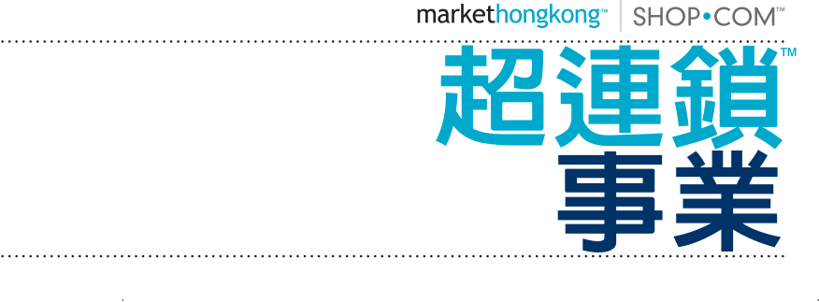
態度與知識
Attitude & Knowledge
目標: 企業家思維
明白、懂得、相信
Shop.com永續收入
Goal: Entrepreneur’s mindset,
understand, believe
Shop.com’s sustainable income

Slide 14
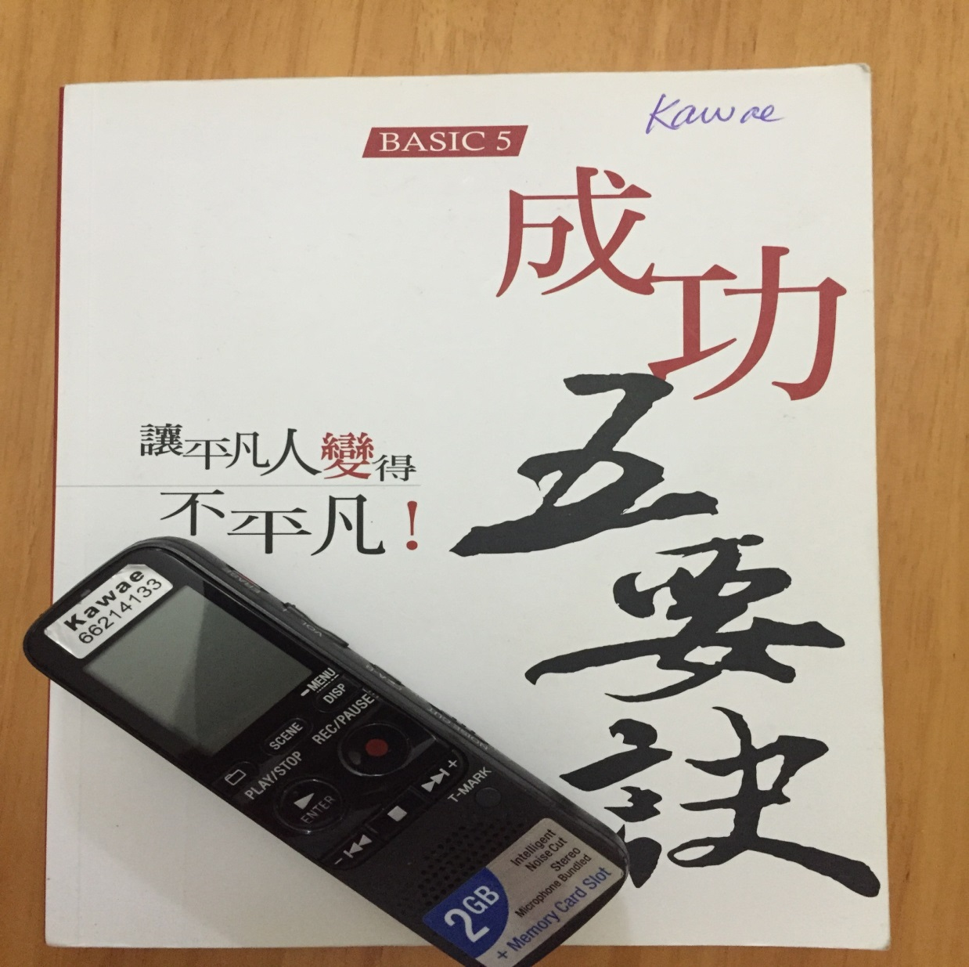
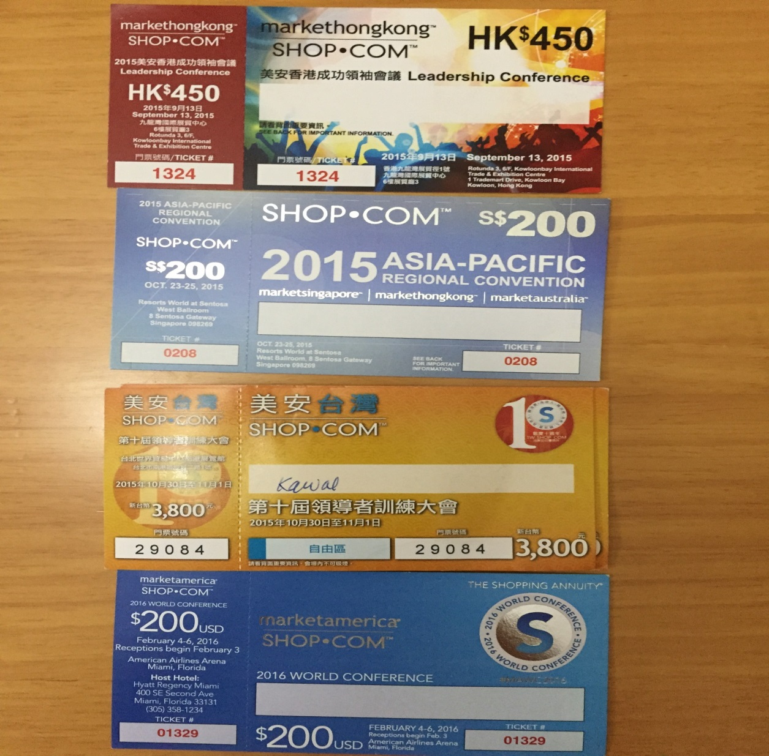

Slide 15
目標與目標宣言
Goals And A Goal Statement
目標:知道自己想要甚麼，相信自己做得到
Define Your Dreams…
Define Your Purpose…

Slide 16
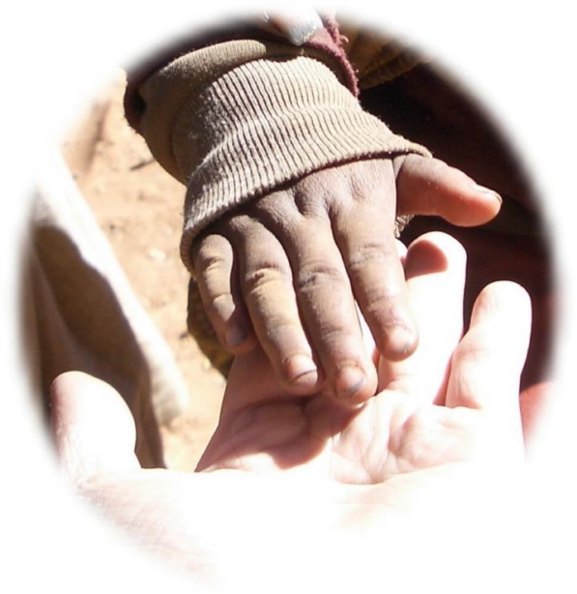
確認目標
生活
房屋/附加裝置…
汽車，第二輛汽車…
電視，電腦，服裝，首飾…
學習
第二語言，樂器…
烹飪，開飛機，潛水…
新技能，新嗜好…
關愛
給配偶送禮，浪漫週末…
給親朋好友送禮…
貢獻
建立基金、獎學金…
幫助他人，慈善事業…
教育，動物救援…
列出短期目標、中期目標和長期目標
依可達成順序列出所有目標
Notes:
16
16

Slide 17
練習Practice
持續每天宣讀
Read it Everyday
加強內在力量
Strengthen the inner strength

Slide 18
零售
Retailing
目標:基本十
450BV/月
Goals: Create a “repeat customer base” of 10 customers that each purchase 450 BV of products monthly.

Slide 19
練習 Practice 分享產品知識、 分享產品體驗、 分享產品見証。 Share products’ knowledge, experiences and testimonials.
Notes:
19
19

Slide 20
發掘人選、招募人才 以及推薦新超連鎖™店主 Prospecting,Recruiting & Sponsoring New UFO
目標:每季2位
Goals: 2 new UFOs quarterly

Slide 21
了解發掘人選、招募人才 以及推薦新超連鎖™店主的全過程 Understanding the Prospecting, Recruiting & Sponsoring Process
Notes:
21
21

Slide 22
練習 Practice 關心朋友、 建立關係、 聆聽需要。 Care for your friends, build relationships, listen to others’ needs.
Notes:
22
22

Slide 23
練習 甚麼是Shop.com 為甚麼做shop.com 正確異議處理 買票賣票 NO = Next One
Practice What is Shop.com Why operate Shop.com
Handling Objections
Buy and sell tickets NO = Next One
Notes:
23
23

Slide 24
跟進追蹤與深層建構的
ABC模式
Follow Up & ABC Pattern of Building Depth
目標:七人強
Goals: Seven Strong

Slide 25
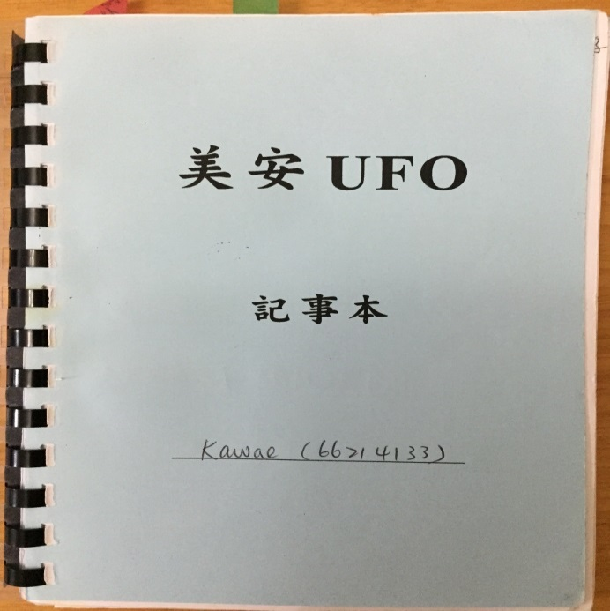
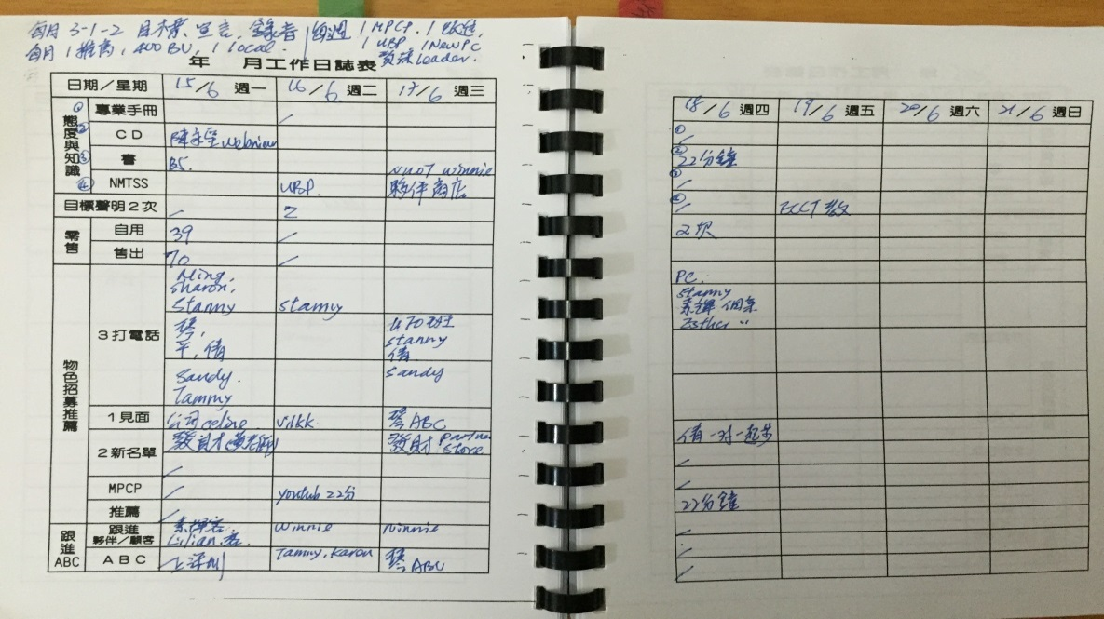
以身作則 Set an example
衡量、審視、調整與控制
Measure, examine, adjust and control
Notes:
25
25

Slide 26
複製與深層建構的ABC模式
資深夥伴
你
A
A
B
B
C
C
A1
A1
B1
B1
C1
C1
A、B、 C等均為積極進取型(Go Now) 超連鎖™店主

Slide 27
執行之成果
0的突破
- 培訓
- 零售
- 擴展

Slide 30
2015 美安香港成功領袖會議
MHK Leadership Conference 2015

